Slide 1

Rewards
A fun way to get your kids to help out!

Slide 2
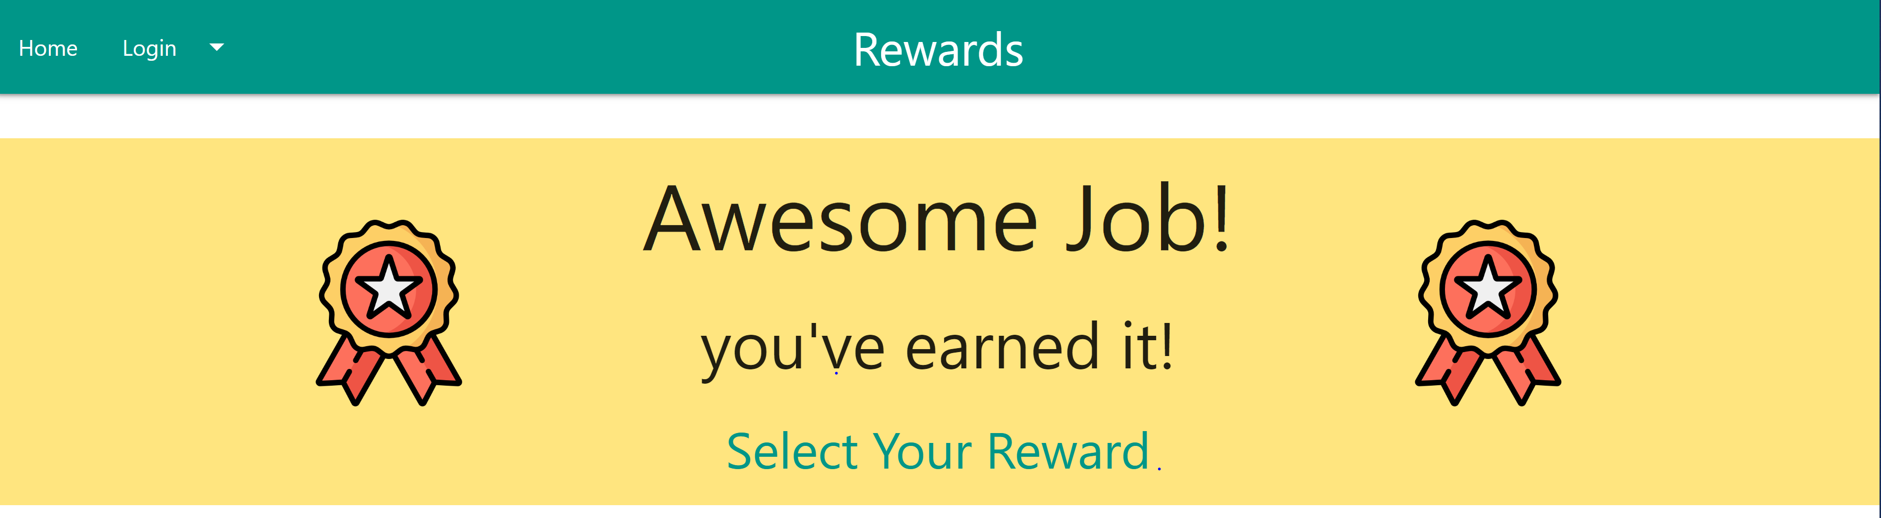
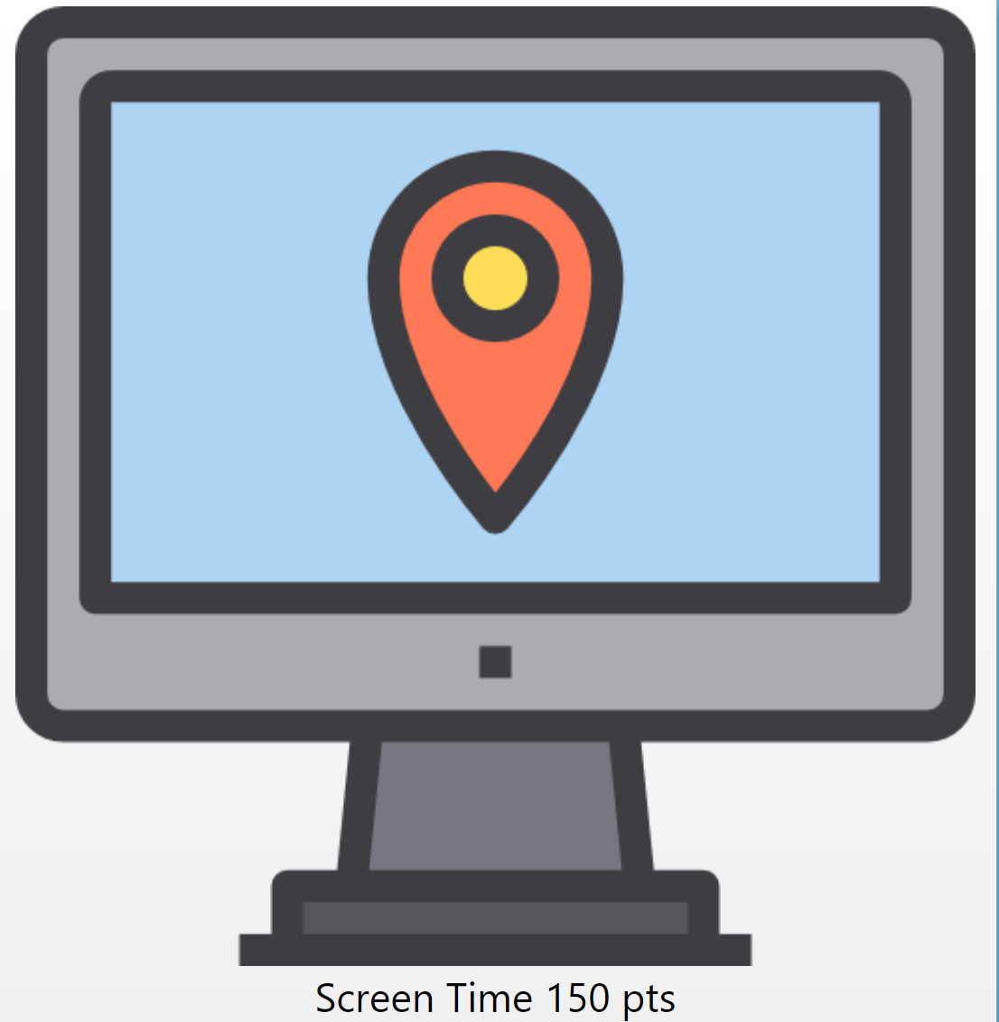
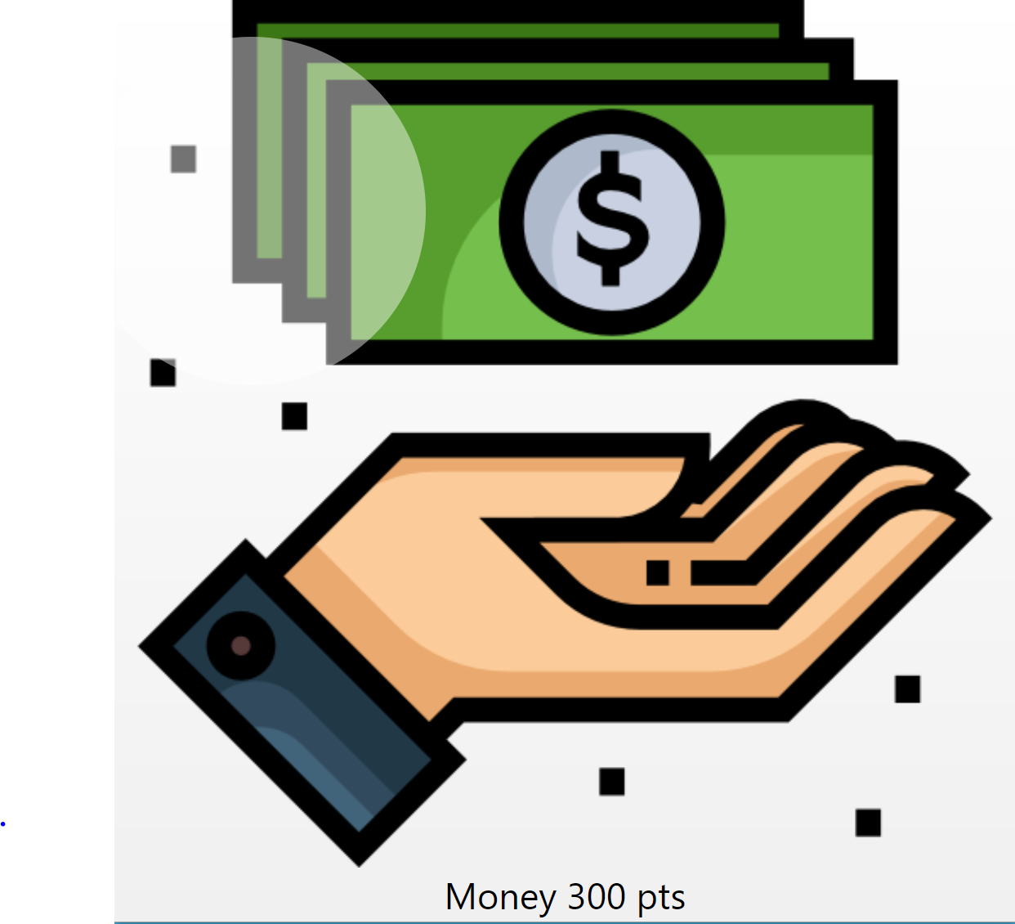
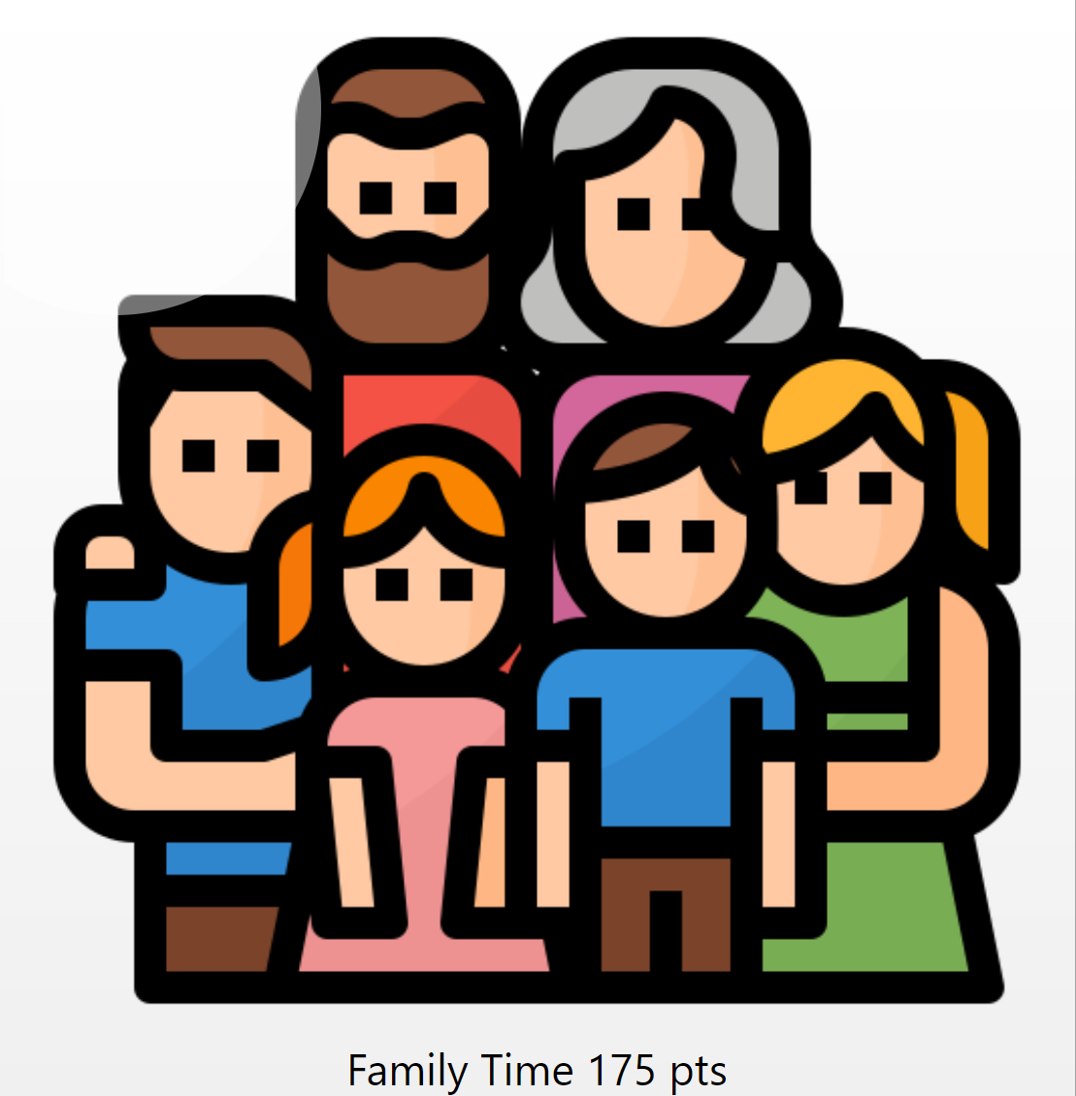
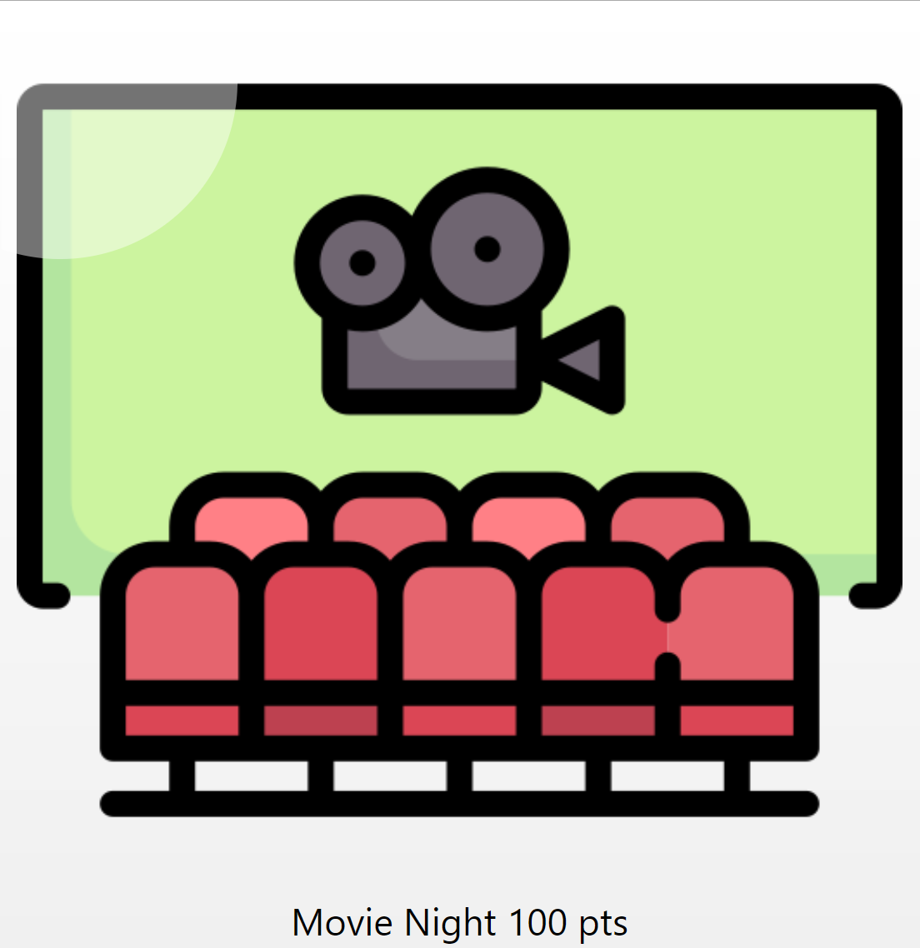
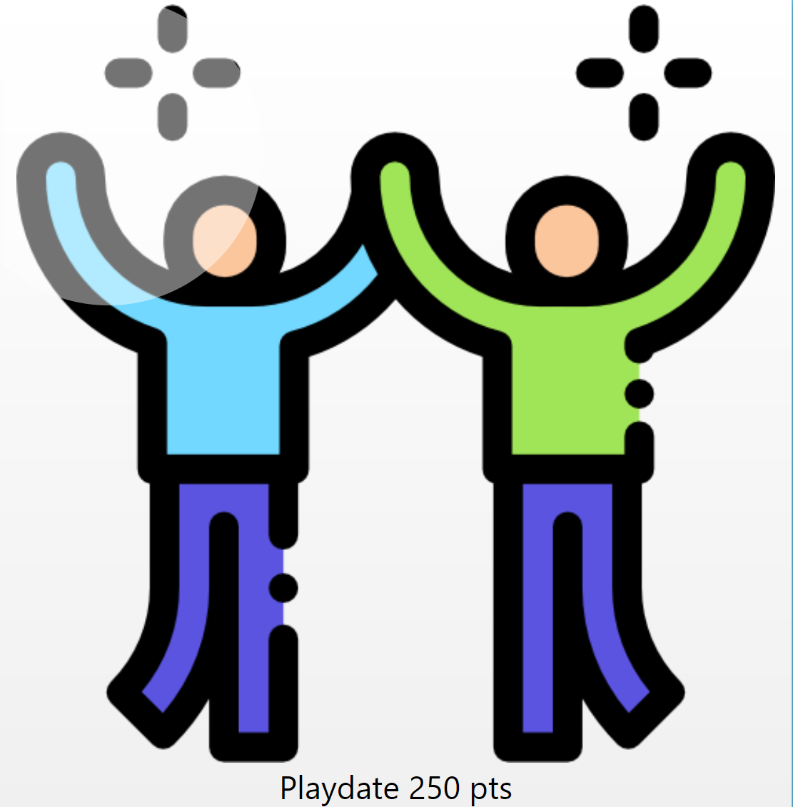

Slide 3

Want more free time for yourself?
Rewards app can help you!
Interactive
Fun way to get your kids to help out
Teaches your child to become responsible citizens early on

Slide 4

Concept
Description:
A user-friendly interactive app that caters to families with children under 12
Motivation:
A fun way to motivate kids to do chores and track it, with a means to reward them
User story
I’m a parent with kids who want to instill a work ethic and help kids learn to be a responsible, participating member of the family, and leave the parents with more time to have fun with the kids.

Slide 5

Process
Technologies used
Sequelize
Materialize CSS (with a little flex-box)
Mailtrap
Nodemailer
Node JS
Express
MVC paradigm
Heroku
Github
Kanban project management

Slide 6

Process (continued)
Breakdown of tasks and roles
Sophie – beautiful front end!
Designed and implemented the html for the polished user interface
Found lots of fun icons!
Andy – great idea, and wrote API routes
Came up with a practical and fun idea that fit the project well
Wrote API and html routes

Slide 7
Process (continued)
Breakdown of tasks and roles
David – researched and implemented a new API
Got our app to send emails!
Cleaned lint from files
Javascript for rewards page
Maura – leader, designed database & worked on underlying Javascript code
Set up database using mySQL and Sequelize
Wrote code to replace static HTML with dynamic code to populate interface from database. Logic to keep track of points & enable/disable buttons where appropriate

Slide 8

Process (continued)
Challenges
Getting the email to work
Getting the list of chore icons to display properly for mobile device
Getting the Javascript code to respond to events on the dynamically added elements
Making the checkmark icon reflect being checked or not
Deployment issues with the database
Successes
Getting all the above to work!

Slide 9

Demo

Slide 10

Directions for Future Development
Authentication
Multiple parents & children
Add / delete parents & children, and rewards & chores
Full email capabilities, and more details in the emails
More modularization and elimination of duplicate code
Choose specific chores and rewards, rather than the whole database
Some customization on the child’s page that the child has control over
Log of past chores completed, and rewards claimed, by date
Click a second time on checked items to un-check or un-choose them
Button on rewards page to go directly back to the chores page

Slide 11

Links
Heroku deployed app:
https://enigmatic-caverns-81757.herokuapp.com/
Github page:
https://github.com/MauraSlavin/rewards

